Slide 1


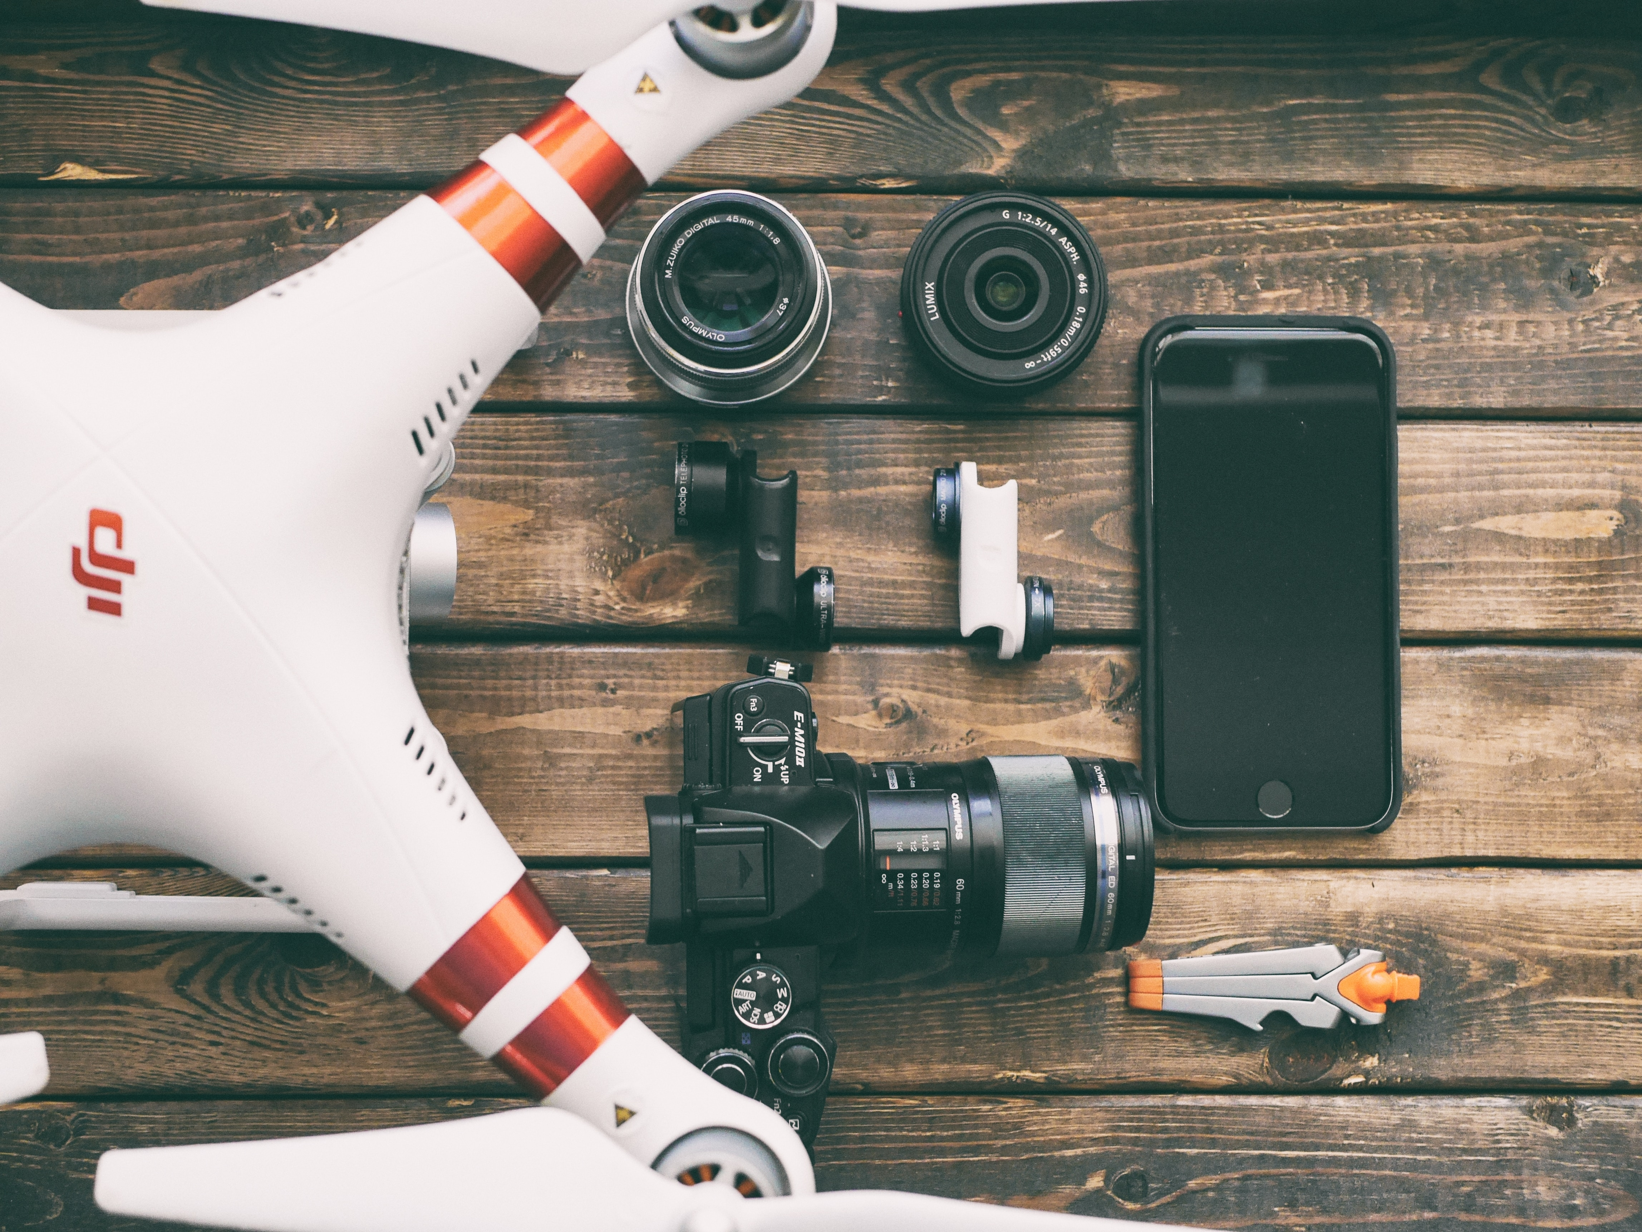
Technology and the Contemporary Environment
CGEO 702

Slide 2
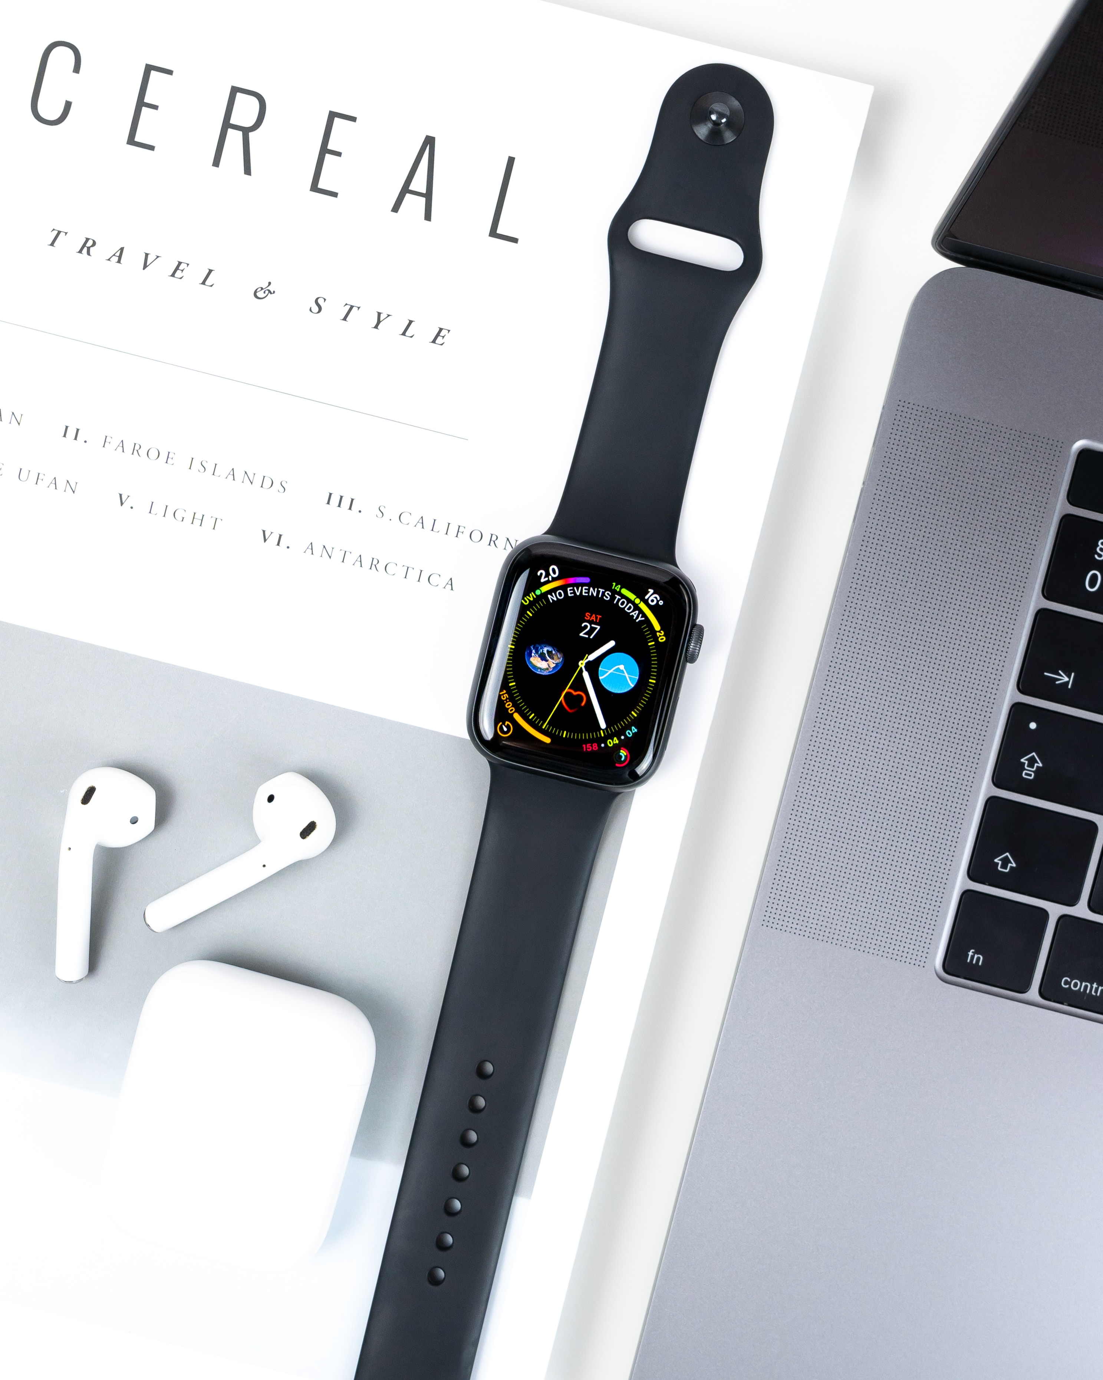
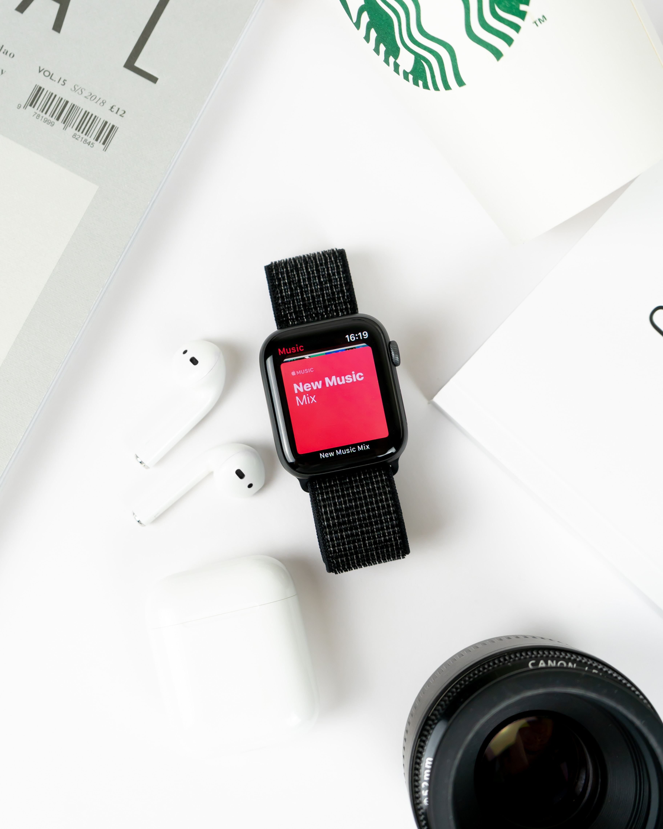
Technology and the Contemporary Environment
Waste Generation, Management, Reduction and Regulation ● An Overview

Slide 3
Technology and the Contemporary Environment
Welcome and Introduction
Before we begin…let me introduce myself!!
Hugh Anthony Simmonds, PhD
Department of Geography and Environmental Studies, Faculty of Arts, Jorgensen Building
Office: JOR 607
Email: hugh.simmonds@torontomu.ca

Slide 4
Technology and the Contemporary Environment
Welcome and Introduction
OFFICE HOURS | BY APPOINTMENT
Mondays : 9:00am – 11:00am
Office : JOR 607
Where : Departure of Geography and
Environmental Studies, Faculty of Arts
Place : Jorgensen Building
(Victoria St. & Gerrard St. East)

Slide 5
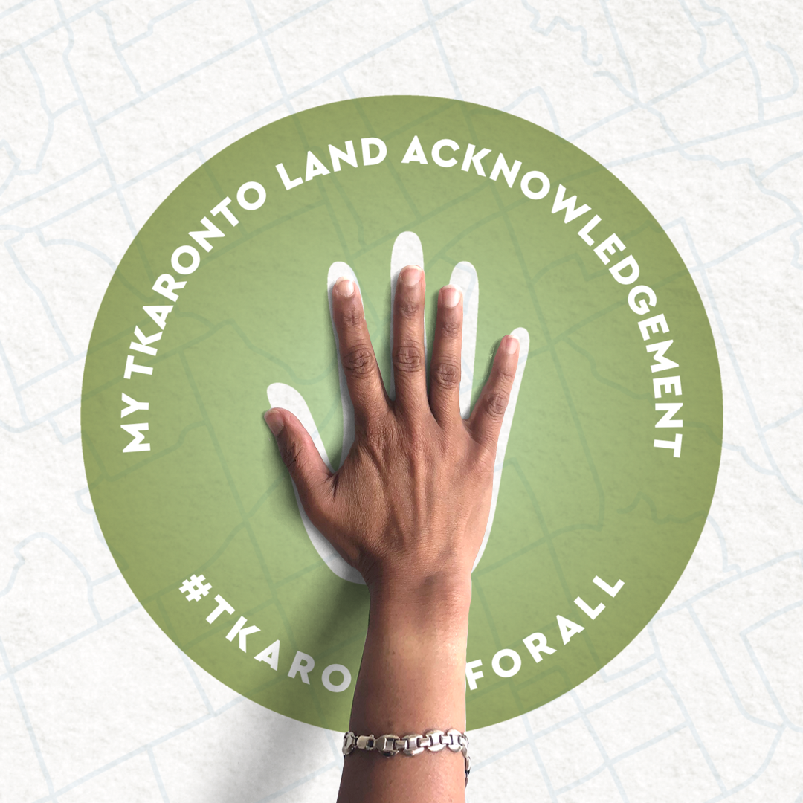
Technology and the Contemporary Environment
Land Acknowledgement
“Toronto is in the ‘Dish With One Spoon Territory’. The Dish With One Spoon is a treaty between the Anishinaabe, Mississaugas and Haudenosaunee that bound them to share the territory and protect the land. Subsequent Indigenous Nations and peoples, Europeans and all newcomers have been invited into this treaty in the spirit of peace, friendship and respect.”
Awakenings: We Were Always Here | Acknowledgment (A film by Jonathan Elliott, 2020)
https://www.youtube.com/watch?v=3X4MYbJvLUI

Slide 6
Technology and the Contemporary Environment
Learning Objectives
Summarize and compare the types of waste we generate, the scale of the waste dilemma, and the major approaches to managing waste.
Describe conventional municipal waste disposal methods: landfills and incineration.
Evaluate approaches for reducing waste: source reduction, reuse, composting, and recycling.
Discuss industrial solid waste management and principles of industrial ecology.
Assess issues in managing hazardous waste and e-waste.

Slide 7
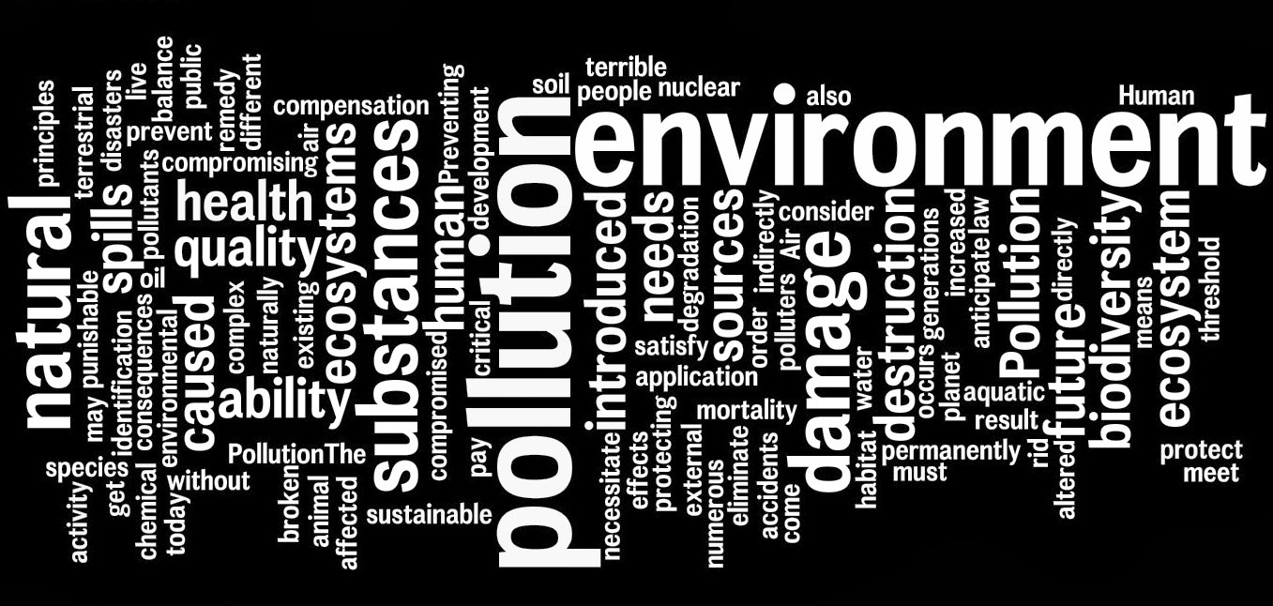
Technology and the Contemporary Environment
Learning Objectives

Slide 8

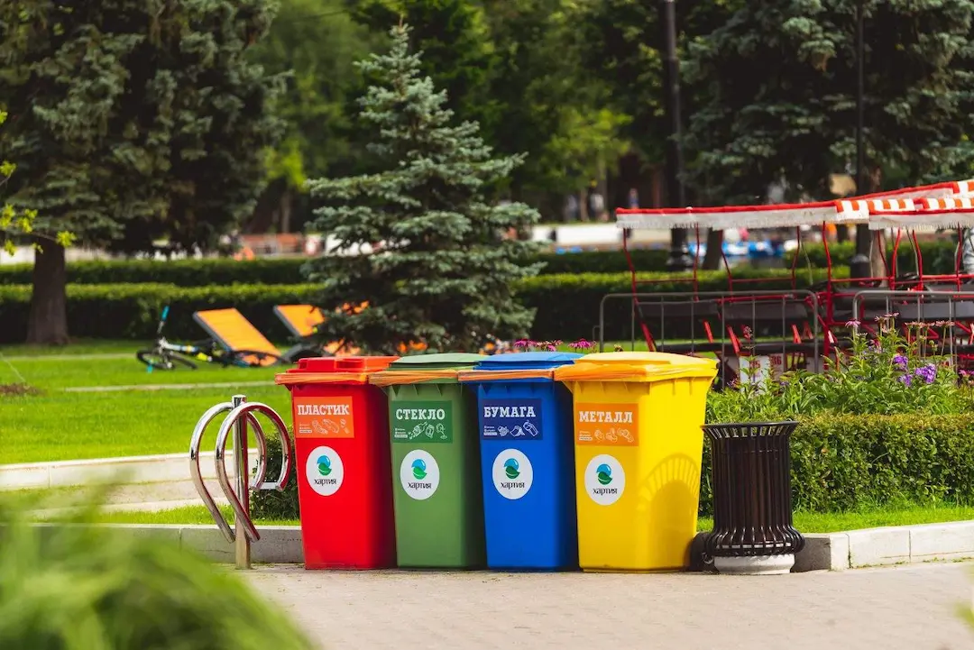

Technology and the Contemporary Environment
Learning Objectives | Introductory Video
Reduce, Reuse, Recycle Household Waste https://www.youtube.com/watch?v=EGzg77rx7Uo

Slide 9
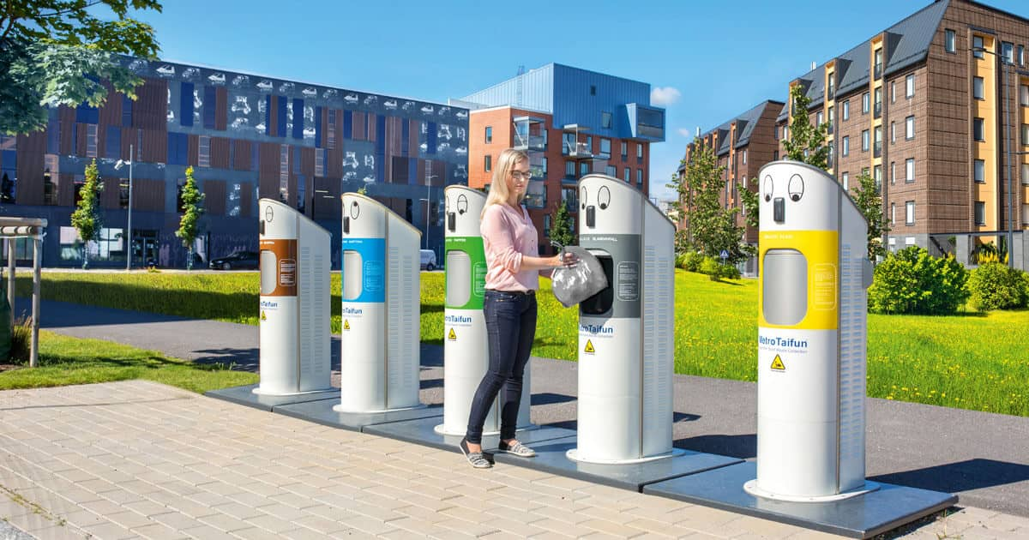
Technology and the Contemporary Environment
Waste Generation, Management, Reduction and Regulation

Slide 10
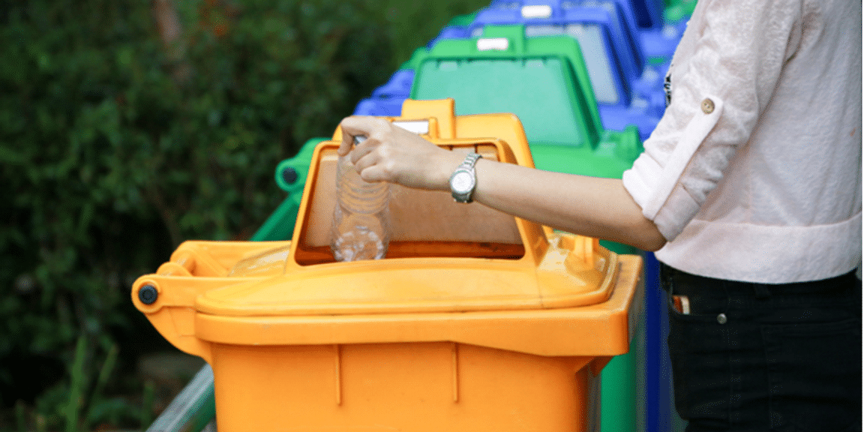
Waste Management

Slide 11
Technology and Contemporary Environment
Waste Management
Centuries ago, people used to dispose of their waste by digging a hole into a far-off land area. This waste disposal technique was meant to be efficient because of less population around that time. Waste production was less due to low population which made waste management easy. But now, due to the growing number of people, waste production has drastically increased making disposal difficult.

Slide 12

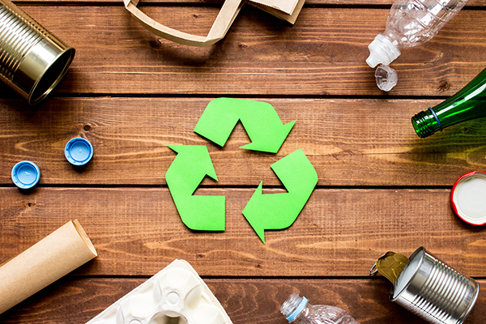
Technology and Contemporary Society
Waste Generation and Management

Slide 13
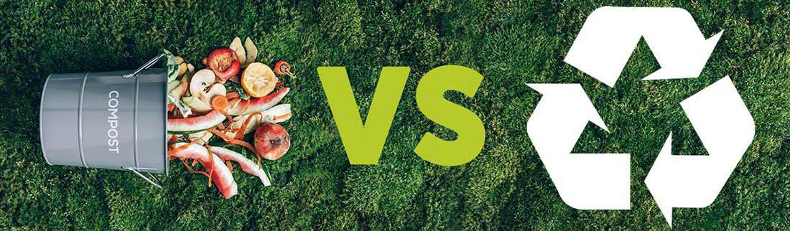
Technology and the Contemporary Environment
Waste Management
Waste management includes all of the processes and activities that involve handling waste materials.
How our cities, towns and regions collect, transports, recycle, and dispose of wastes may seem mundane in the grand scheme of things, but responsible waste management is more impactful to our society than you might think.

Slide 14
Technology and the Contemporary Environment
Waste Management
As the world’s population increases, and as we produce and
consume more material goods, we generate more waste.
Waste refers to any unwanted material or substance that results from a human activity or process. The federal government of Canada has adopted a definition that states, in part, that waste is “any substance for which the owner/generator has no further use”.
Another popular definition suggests that waste is “resources out of place,” emphasizing the fact that most waste still contains a significant proportion of useful materials. These definitions represent a changing perception of waste—that there is much of value that can be recovered from our waste.

Slide 15
Technology and the Contemporary Environment
Waste Management
As our global population continues to expand, so does the amount of waste we produce. The quantity of garbage we release today is in fact unprecedented.
Consequently, effective waste management has become an indispensable pillar to prevent the critical implications that derive from uncontrolled waste production - such as resource inefficiency, climate change, health consequences - and for achieving sustainability and ensuring a greener future for our planet.
With the deteriorating Earth state that we live in nowadays, waste management appears to be one of the most important environmental protection strategies

Slide 16
Technology and the Contemporary Environment
Waste Management
Waste management reduces the effect of waste on the environment, health, and wellbeing, and is actually very important in our daily lives.
Waste management is a universal issue that affects every single person in the world and poor management waste can harm our health, our environment, and even our prosperity.
Waste management is the processes and practices aimed at collecting, transporting and disposing of garbage, sewage and other waste products.

Slide 17
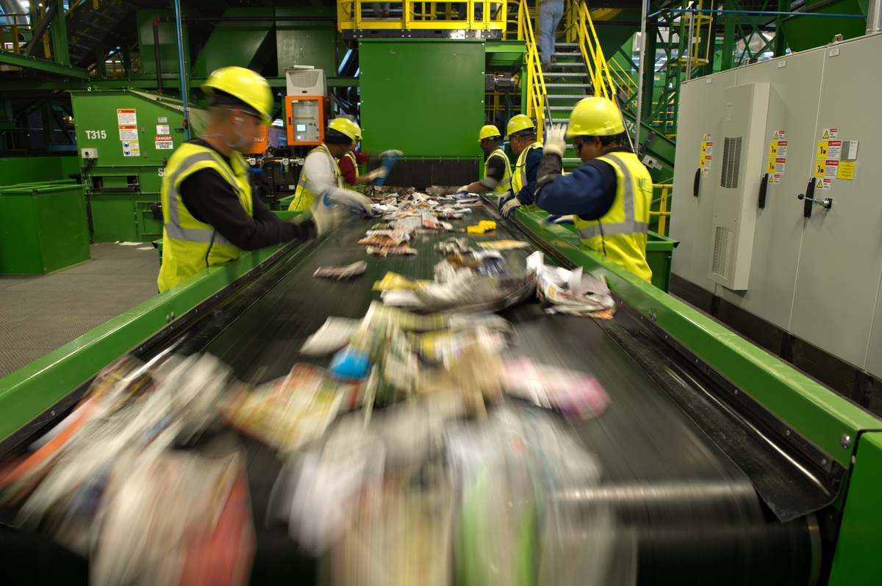
WASTE MANAGEMENT
Technology and the Contemporary Environment
Planning for tomorrow: Toronto's long term waste resource management strategy
https://www.youtube.com/watch?v=glW01V3ugfk
Notes:
https://www.youtube.com/watch?v=_dWJVHIE9S8&t=3s

Slide 18
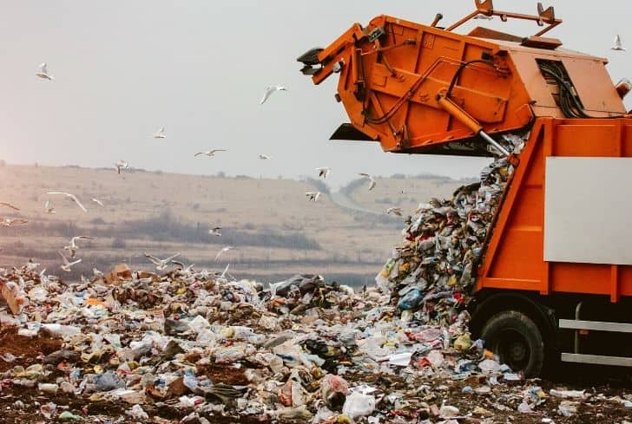

Technology and the Contemporary Environment
In North America since 1960, total waste generation has increased by almost 300%, and per capita waste generation has risen by about 70%.
Plastics, which came into wide consumer use only after 1970, have accounted for the greatest relative increase in the waste stream during last several decades.
Global waste volumes are expected to increase by 70 percent by 2050 based on current levels, according to the World Bank

Slide 19
Technology and the Contemporary Environment
Waste Management
In the past decade or so, waste generation in Canada has kept pace with the growth rate of the population but has lagged slightly behind the growth in gross domestic product (GDP).
The intensive consumption that has long characterized wealthy nations is now increasing rapidly in developing nations.
To some extent, this reflects rising material standards of living, but an increase in packaging is also to blame. Items made for temporary use and poor-quality goods designed to be inexpensive wear out and pile up quickly as trash, littering the landscapes of countries from Mexico to Kenya to Indonesia.

Slide 20
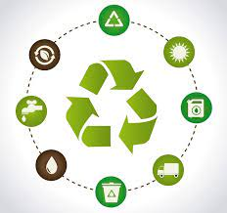
Technology and the Contemporary Environment
Waste Management
The waste produced nowadays includes non-biodegradable and inorganic elements. If this waste is disposed of in landfills, it will decompose unnaturally and will take a lot of time. Waste management allows users to efficiently and properly dispose of all kinds of waste.
Waste Management and Recycling
https://www.youtube.com/watch?v=4JDGFNoY-rQ&t=13s

Slide 21
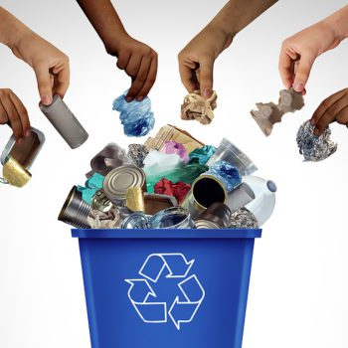
Technology and the Contemporary Environment
Waste Management
Consumption leads to increased waste generation
Rise in wealth of developed and developing countries lead to more packaging.
Items made for temporary use pile up quickly
Wealthy consumers often throw material out that still can be used.
Per capita waste in industrialized nations declining
Recycling, composting, reduction, reusing

Slide 22
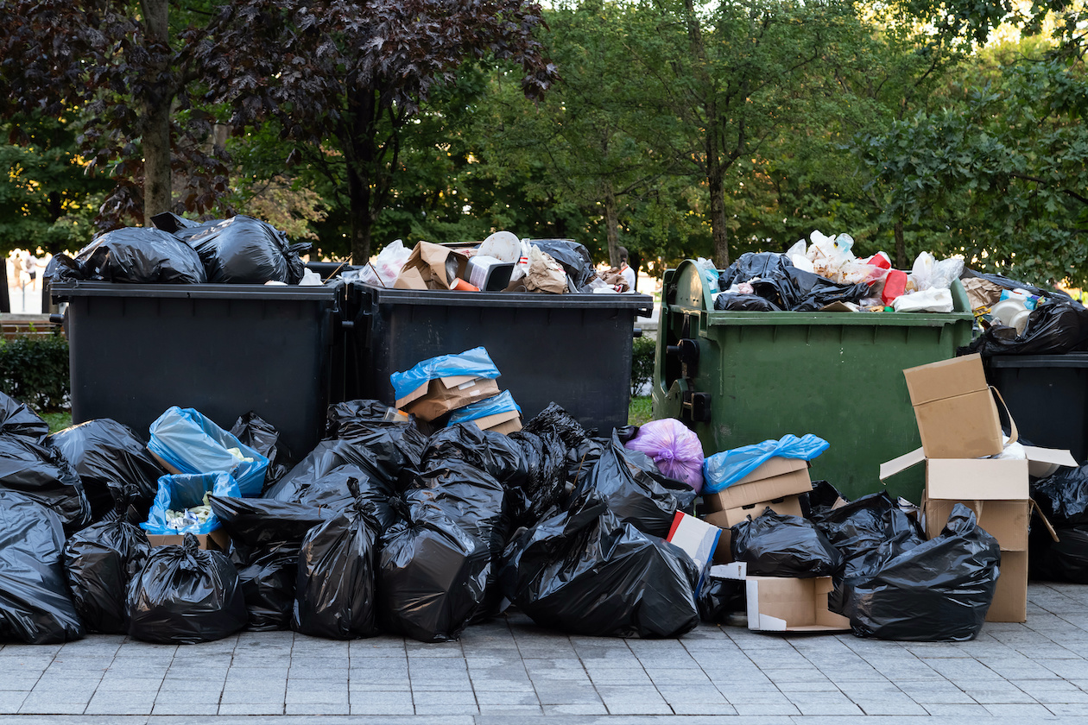
The Importance of Waste Management

Slide 23
Technology and the Contemporary Environment
Waste Management
Waste can degrade water quality, soil quality, and air quality, thereby degrading human health and the environment.
Waste is also a measure of inefficiency, so reducing waste can potentially save industry, municipalities, and consumers both money and resources.
In addition, waste is unpleasant aesthetically. For these and other reasons, waste management has become a vital pursuit.

Slide 24
Technology and the Contemporary Environment
Waste Management
Food waste, when disposed of in garbage bins and landfills, undergoes decomposition in the absence of oxygen, releasing methane gas into the atmosphere.
Methane, as a greenhouse gas, poses a greater threat to our environment compared to carbon dioxide. According to data from the Environmental Defence Fund (EDF), methane is 84 times more destructive to the ecosystem within the first 20 years following its release.
Effective waste management plays a pivotal role in safeguarding our planet's biodiversity, preserving natural resources, and enhancing the quality of human life.

Slide 25
Technology and the Contemporary Environment
Waste Management
The goal of waste management is to increase the product’s lifecycle and reuse and recover materials where possible, in order to reduce the total amount of waste that goes into landfill and minimize the environmental burden.
The final goal pursued through this practice is thus to recreate a valuable resource through responsible disposal of rubbish, which is why waste management plays a crucial role in supporting sustainable development and the transition towards circular economy.

Slide 26
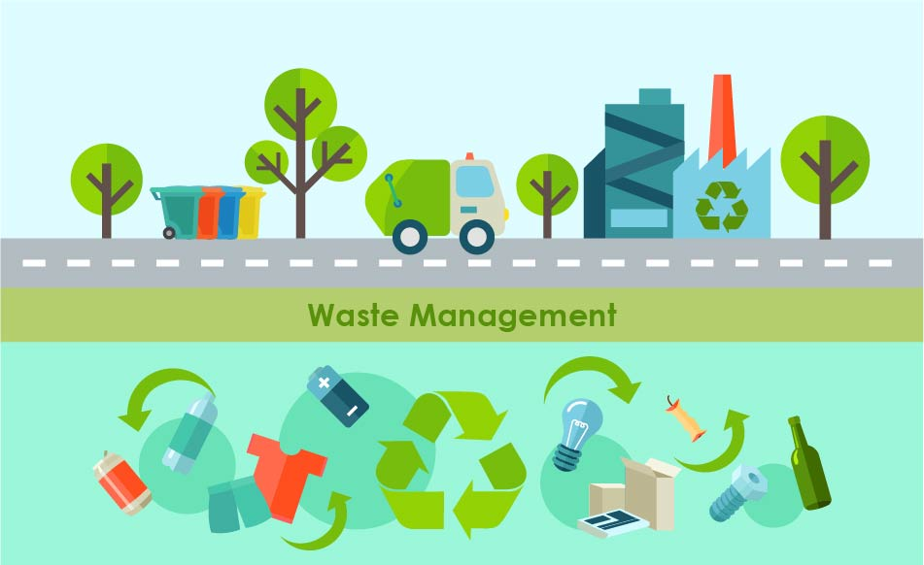
Benefits of Waste Management

Slide 27
Technology and the Contemporary Environment
The Main Benefits of Waste Management
Environmental protection and pollution reduction: One of the primary benefits of waste management lies in its ability to minimize the environmental impact of human activities.
Resource conservation: Waste management fosters resource conservation through recycling and reusing materials, reducing the total amount of material reaching final disposal.
Economic benefits: There are plenty of economic benefits deriving from waste management: not only this practice reduces the overall cost of waste disposal, but also fosters the creation of job opportunities.

Slide 28
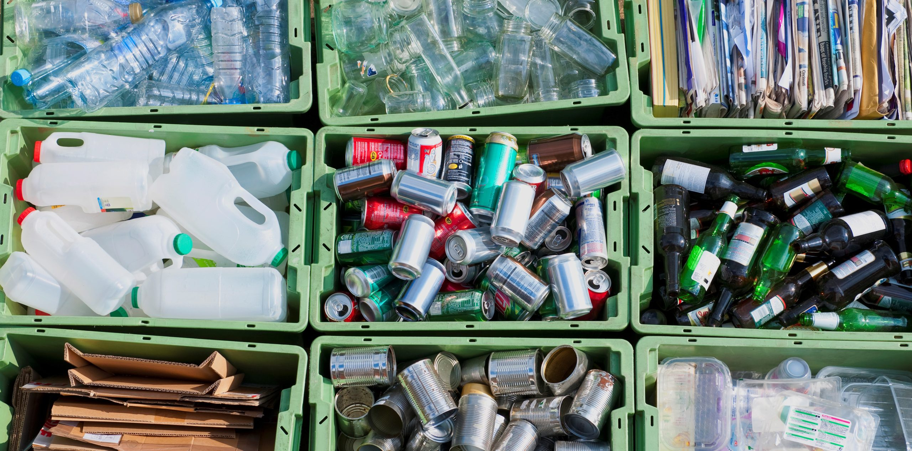
Technology and the Contemporary Environment
The Main Benefits of Waste Management
Enabling a circular economy: Waste management is a key enabler of the circular economy, a model aimed at reducing waste and optimizing resource use. In a circular economy, products and materials are designed for longevity, reuse, and recyclability.

Slide 29
Waste Disposal Categories

Slide 30
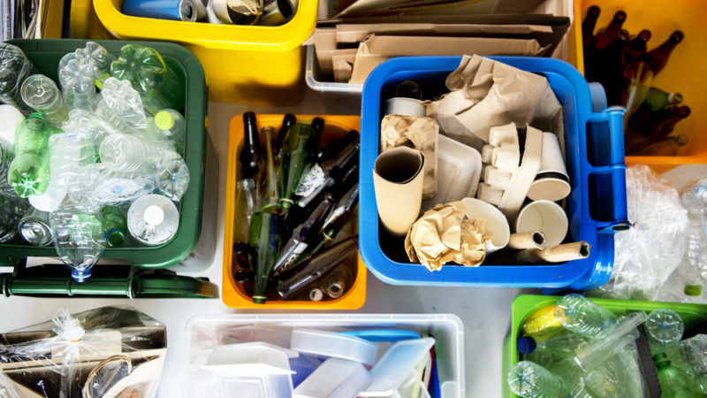
Technology and the Contemporary Environment
Waste Management
For management purposes, waste is divided into four categories:
Municipal solid waste
Industrial waste
Hazardous waste
Waste water

Slide 31
Technology and the Contemporary Environment
Waste Management
Municipal solid waste is the non-liquid waste that comes from homes, institutions, and small businesses
Industrial solid waste is the waste from production of consumer goods, mining, agriculture, and petroleum extraction and refining
Hazardous waste is the solid or liquid waste that is toxic, chemically reactive, flammable, or corrosive
Wastewater is water used in a household, business, or industry, as well as polluted runoff from our streets and storm drains

Slide 32
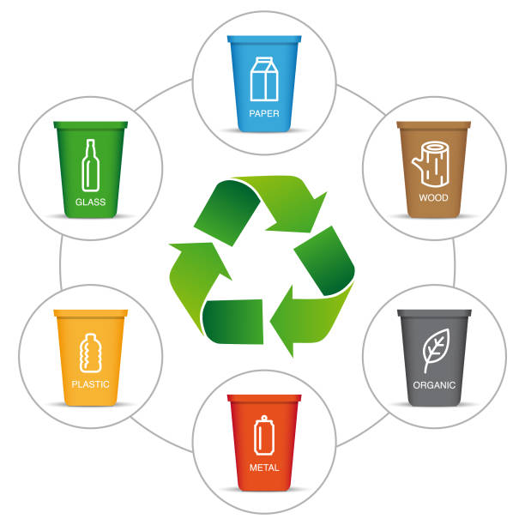
Technology and the Contemporary Environment
Waste Management
Three main components of waste management
Minimizing the amount of waste we generate (source reduction)
Recovering waste materials and finding ways to recycle them
Disposing of waste safely and effectively

Slide 33
Technology and the Contemporary Environment
Waste Management : Levels of Governance
Municipal:
Collection, diversion, and disposal of solid waste
Drop-off facilities for hazardous waste
Provincial and territorial:
Movement of waste materials within the jurisdiction
Licensing of treatment facilities
Legislation and guidelines for landfill sites
Federal government:
International agreements about waste
Transboundary movements of waste materials

Slide 34
Technology and the Contemporary Environment
Waste Management
Waste stream is the flow of waste as it moves from its sources toward disposal destinations.
More efficient use of materials, consume less, buy goods with less packaging, reusing goods.
Recovery (recycling, composting) is the next best strategy in waste management.
Recycling is sending used goods to manufacture new goods.
Composting is the recovery of organic waste.

Slide 35
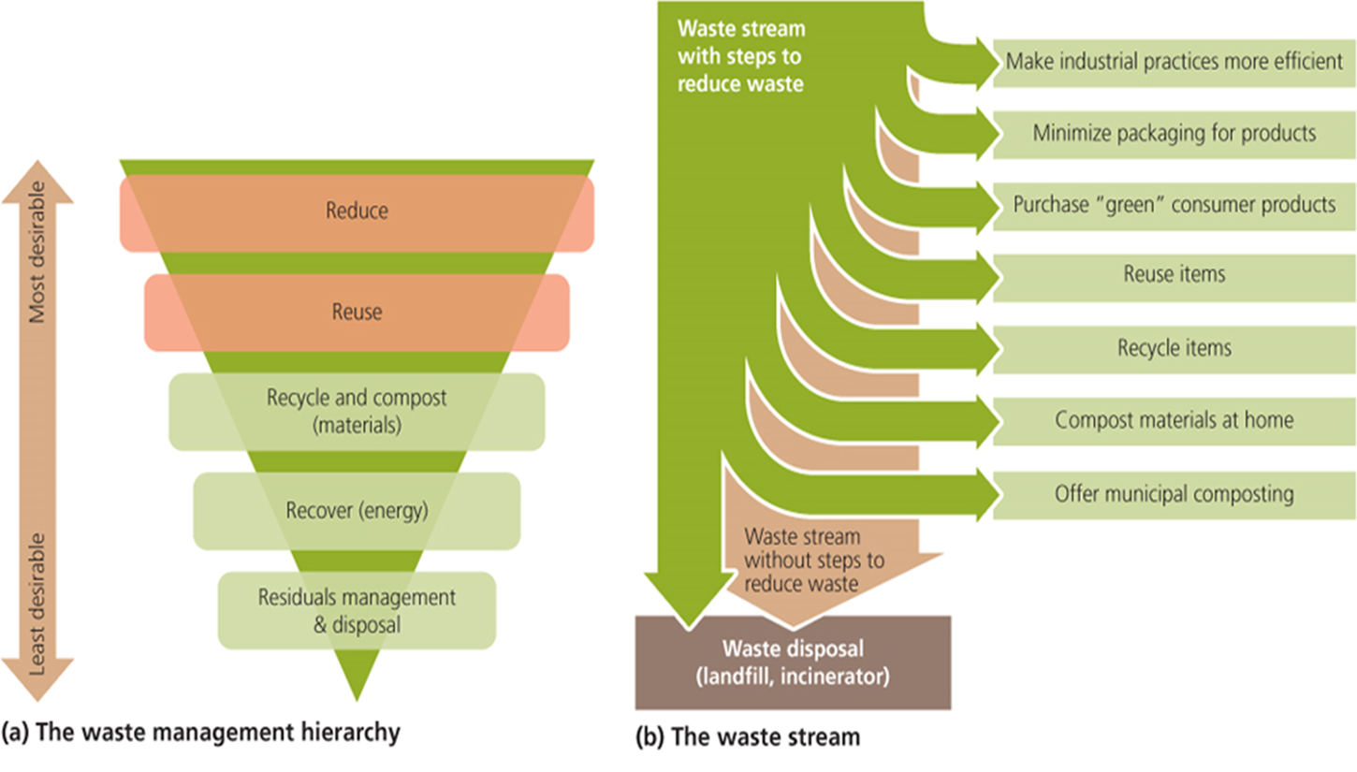
Technology and the Contemporary Environment
Waste Management

Slide 36
Technology and the Contemporary Environment
Methods of Waste Disposal
How San Francisco Is Becoming A Zero Waste City
https://www.youtube.com/watch?v=Cg3OA1s8-SI

Slide 37
Technology and the Contemporary Environment
Waste Management: Methods of Waste Disposal
Non-biodegradable and toxic wastes like radioactive remnants can potentially cause irreparable damage to the environment and human health if not strategically disposed of. Waste disposal has been a matter of concern, the main problem growth in population and industrialization. Here are four methods of waste disposal.
Landfills: Throwing daily waste/garbage in the landfills is the most popularly used method of waste disposal used today. This process of waste disposal focuses attention on burying the waste in the land.

Slide 38
Technology and the Contemporary Environment
Waste Management: Methods of Waste Disposal
Recycling: Recycling is the process of converting waste products into new products to prevent energy usage and consumption of fresh raw materials. Recycling is to reduce energy usage, reduce the volume of landfills, reduce air and water pollution, reduce greenhouse gas emissions, and preserve natural resources for future use.
Composting: This is an easy and natural bio-degradation process that takes organic wastes i.e. remains of plants and garden and kitchen waste and turns into nutrient-rich food for your plants.

Slide 39
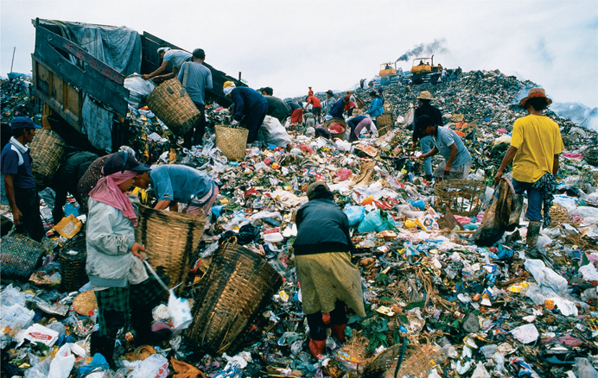
Technology and the Contemporary Environment
Waste Management: Methods of Waste Disposal
Incineration: It involves the combustion of waste materials. With this method, the waste material is heated to very high temperatures and is converted into materials such as heat, gas, steam, and ash.

Slide 40
Technology and Contemporary Society
Methods of Waste Disposal

Slide 41
Technology and the Contemporary Environment
Waste Management
Open dumping has given way to improved disposal methods
Historically people dumped their garbage wherever it suited them
Most industrialized nations now bury waste in lined and covered landfills or burn it in incineration facilities.
Diversion rates are increasing in Canada. In 2018, residential sources were responsible for 53% of diverted solid waste and 42% of disposed solid waste. From 2002 to 2018, the amount of solid waste diverted from residential sources increased by 74% (or 2.1 million tonnes), while the amount of waste disposed increased by 28% (or 2.4 million tonnes).

Slide 42
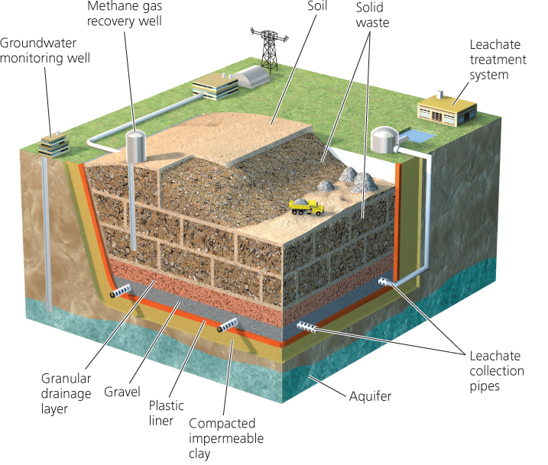
Technology and the Contemporary Environment
Waste Management
Sanitary landfills are engineered to minimize leakage of contaminants
Sanitary landfills are where waste buried in the ground or piled in large, engineered mounds
Leachate are liquid that results when trash dissolves in water as rainwater percolates downward

Slide 43
Technology and the Contemporary Environment
Waste Management
Landfills can be transformed after closure
Many landfills lie abandoned
Managers closed smaller landfills and made fewer larger landfills
Decommissioning is the shutting down an industrial site and getting it ready for cleanup and repurposing.
Growing cities converted closed landfills into public parks
Rouge Park in Toronto | Fresh Kills in New York

Slide 44
Technology and the Contemporary Environment
Waste Management
Incinerating trash can reduce pressure on landfills
Incineration is a controlled process in which mixed garbage is burned at very high temperatures
Incineration in specially constructed facilities can be an improvement over open-air burning of trash. But, the remaining ash must be disposed of in a hazardous waste landfill
Hazardous chemicals are created and released during burning
Scrubbers = chemically treat the gases produced in combustion to remove hazardous components and neutralize acidic gases
Baghouse is system of filters

Slide 45
Technology and the Contemporary Environment
Waste Management
Landfills and incinerators can be used to generate power
Waste-to-energy facilities (WTE) is the use of heat produced by waste combustion to create electricity
Waste generates about 35% of the energy generated by burning coal
Companies contract with communities to guarantee a minimum amount of garbage
Long-term commitments interfere with the communities’ later efforts to reduce waste

Slide 46
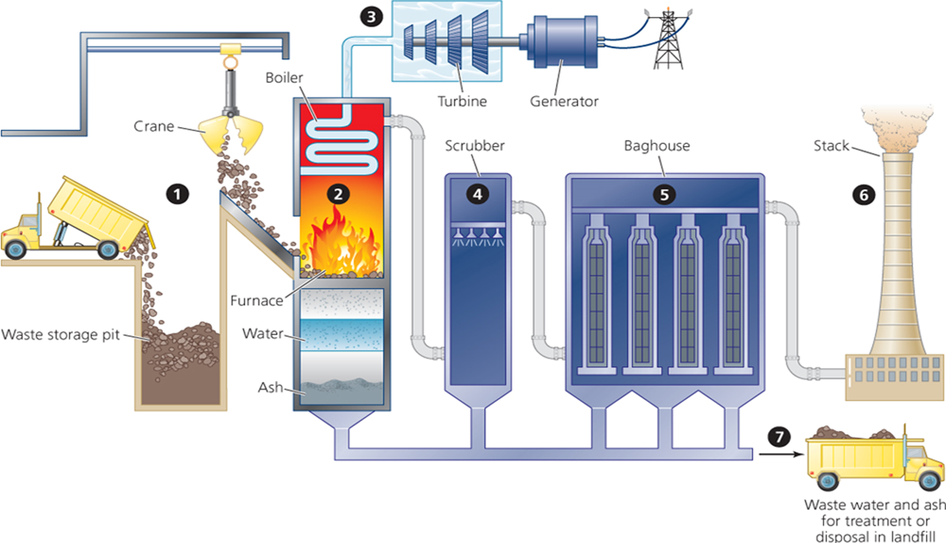
Technology and the Contemporary Environment
Methods of Waste Disposal

Slide 47
Technology and the Contemporary Environment
Waste Management
Landfills and incinerators can be used to generate power
Bacteria can decompose waste in an oxygen-deficient environment
Landfill gas is a mix of gases that consists of roughly half methane
Can be collected, processed, and used like natural gas
When not used commercially, landfill gas is burned off in flares to reduce odors and greenhouse emissions
Many facilities in Canada collect landfill gas and convert it into energy

Slide 48
Technology and Contemporary Society
Methods of Waste Disposal
Waste Management
https://www.youtube.com/watch?v=8krzjlHaGes&t=2s

Slide 49
Technology and the Contemporary Environment
Waste Management
Waste management is important as it saves the environment from the toxic effects of inorganic and biodegradable element present in waste.
Mismanagement of waste can cause water contamination, soil erosion and air contamination.
Waste can be recycled if collected and managed efficiently.
Waste materials such as plastic, glass and paper can be segregated into different columns in order to process them to make new products which will save the natural resources.

Slide 50
Technology and the Contemporary Environment
Waste Management
Moreover, when this waste is not recycled, it usually ends up in landfills or oceans posing threat to human health and marine life.
In most areas of the world, sewage treatment is not done properly, leading to eutrophication and beach closures.
According to World Wildlife Fund (WWF) an estimate of 8,000,000 ton plastic ends up in oceans each year.

Slide 51
Technology and the Contemporary Environment
Waste Management
Waste management will not only save natural resources, biodiversity, and human life, it will also impact the economy in a positive way as there will be more jobs created for running an efficient waste management system.
In developed countries waste is disposed into garbage disposal sites while in developing economies the waste usually ends up on streets and vacant areas.
When this untreated waste is exposed to the air, it causes environmental hazards and also impacts the infrastructure.

Slide 52
Technology and the Contemporary Environment
Waste Management
With the passage of time, waste management is becoming more important not just for environmental protection but also as a growing industry for an economy.
Businesses can save money by recycling the materials they produce. This would help decrease their waste disposal costs. Moreover, having knowledge about the different kinds of waste the company is creating, would make it easier for them to find waste management services according to their need and minimize their transportation costs.

Slide 53

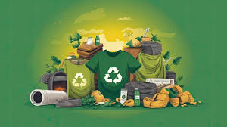

Technology and the Contemporary Environment
Waste Management
In addition to this, it helps environmental sustainability by minimizing emissions of greenhouse gases and preserving natural resources which in turn promotes the good image of the business.
Restaurants can giveaway perishable food items to the needy instead of wasting them and causing harm to the environment.

Slide 54
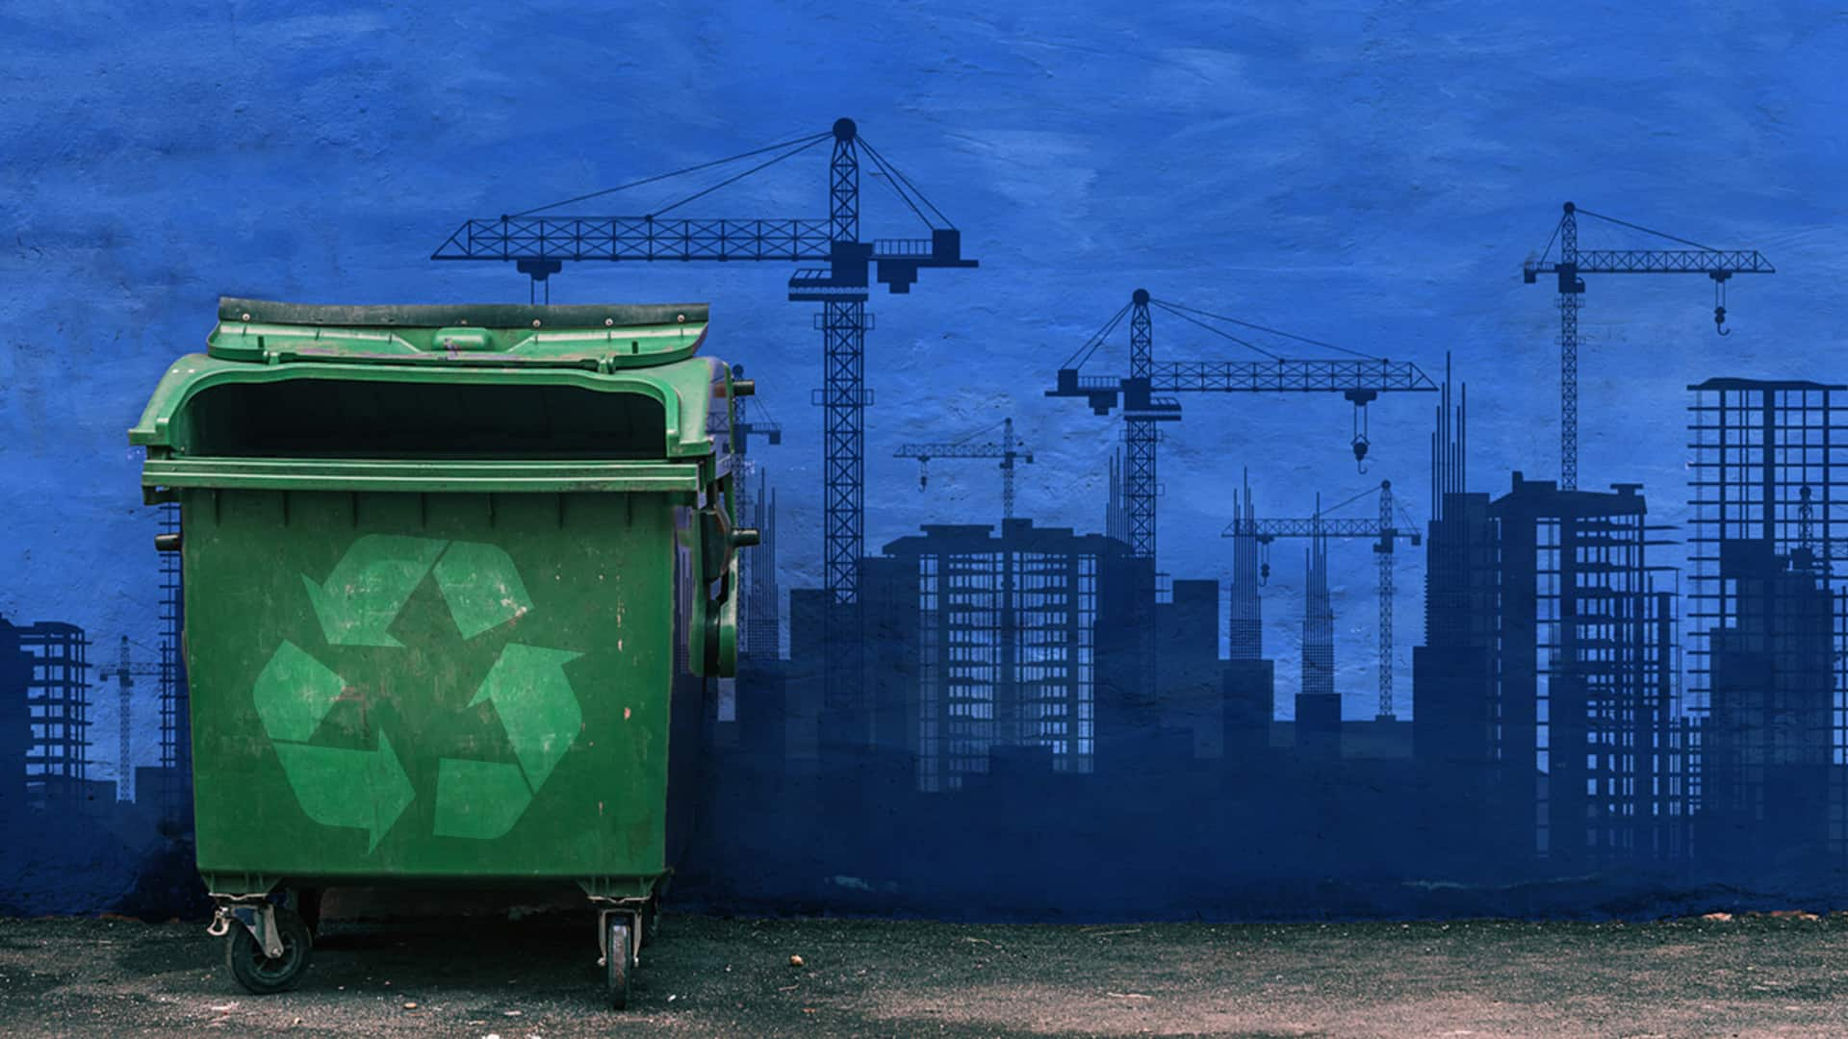
Technology and Contemporary Society
Methods of Waste Disposal
How Trash Makes Money In The U.S.
https://www.youtube.com/watch?v=uUmtJIBibMM

Slide 55
Technology and the Contemporary Environment
E Waste Disposal

Slide 56
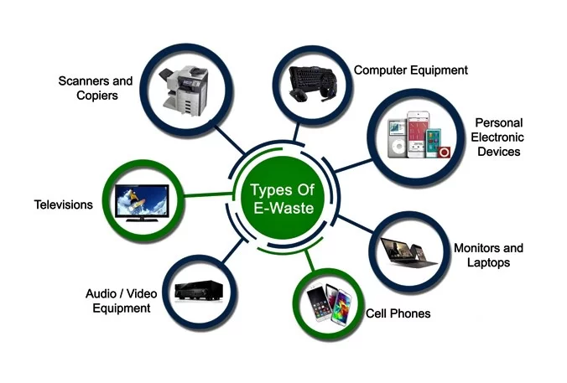
Technology and the Contemporary Environment
E Waste Disposal

Slide 57
Technology and the Contemporary Environment
E-Waste Disposal
Electronic waste (e-waste) is one of the fastest-growing pollution problems worldwide given the presence if a variety of toxic substances which can contaminate the environment and threaten human health, if disposal protocols are not meticulously managed (Kiddee, et al, 2012).
E-waste disposal methods include landfill and incineration, both of which pose considerable contamination risks. Landfill leachates can potentially transport toxic substances into groundwater whilst combustion in an incinerator can emit toxic gases into the atmosphere.

Slide 58
Technology and the Contemporary Environment
E-Waste Disposal
Managing electronic waste (or e-waste) is one of the most rapidly growing pollution problems worldwide. New technologies are rapidly superseding millions of analogue appliances leading to their disposal in prescribed landfills despite potentially their adverse impacts on the environment.
E-waste consists of a large variety of materials (Zhang and Forssberg, 1997), some of which contain a range of toxic substances that can contaminate the environment and threaten human health if not appropriately managed.
The rapid growth of e-waste and the ineffectiveness of legislation has led to inappropriate management strategies in both developed and developing countries, leading to profound impacts on the environment.

Slide 59
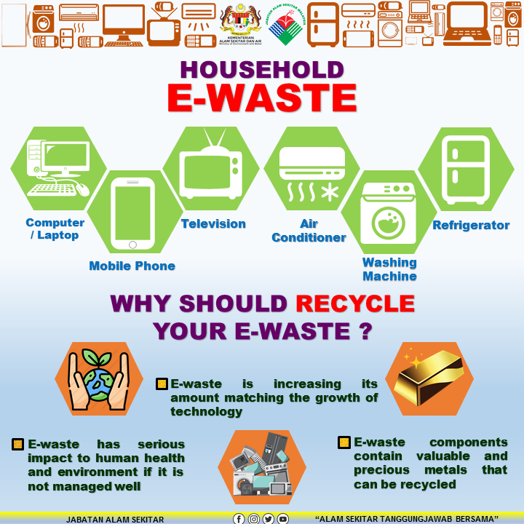
Technology and the Contemporary Environment
E-Waste Disposal
The key to success in terms of e-waste management is to develop eco-design devices, properly collect e-waste, recover and recycle material by safe methods, dispose of e-waste by suitable techniques, restrict the transfer of used electronic devices to developing countries, and raise awareness of the effect of e-waste.

Slide 60
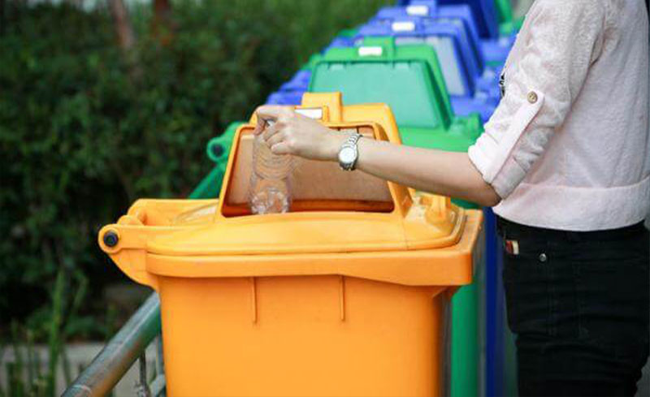
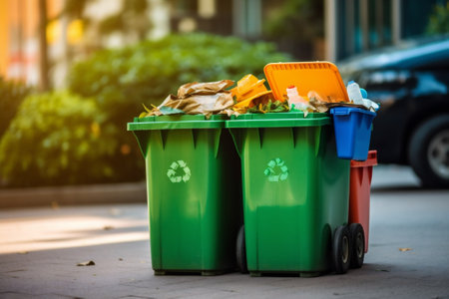
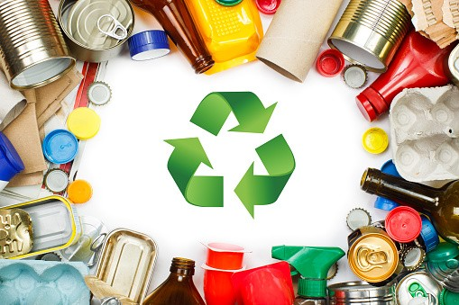
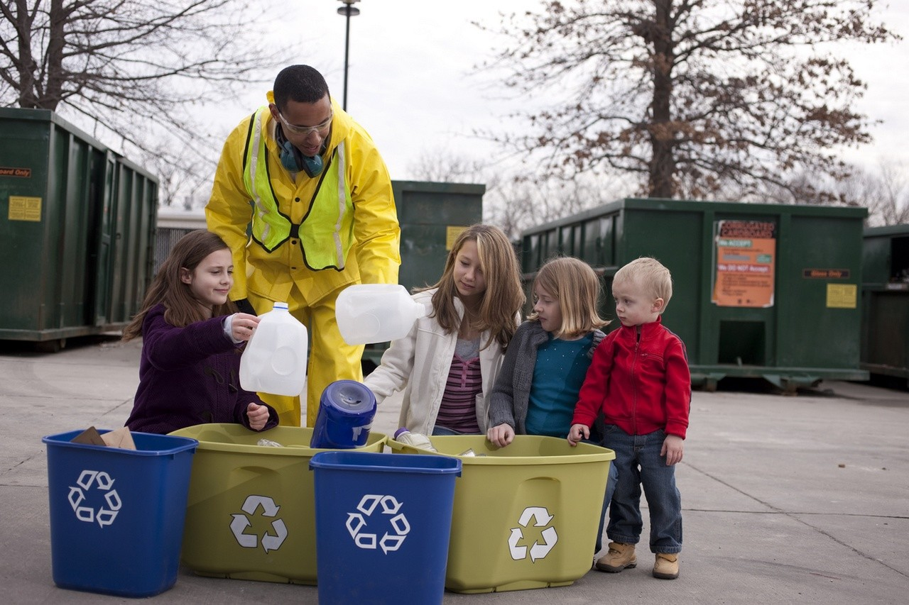
Technology and Contemporary Environment
Waste Reduction and Recycling
Methods of Waste Disposal
Reduce, Reuse, Recycle!
https://www.youtube.com/watch?v=i4a7aeA8F60

Slide 61
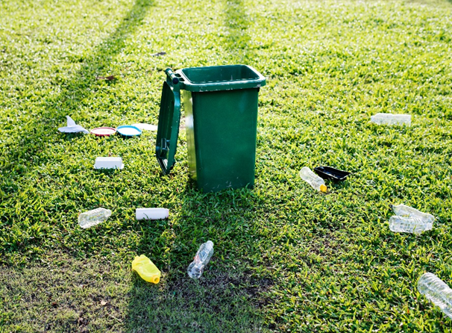
Technology and the Contemporary Environment
Waste Reduction and Recycling
Source reduction is about preventing waste generation in the first place
Avoids costs of disposal and recycling
Helps conserve resources
Minimizes pollution
Can save consumers and businesses money

Slide 62
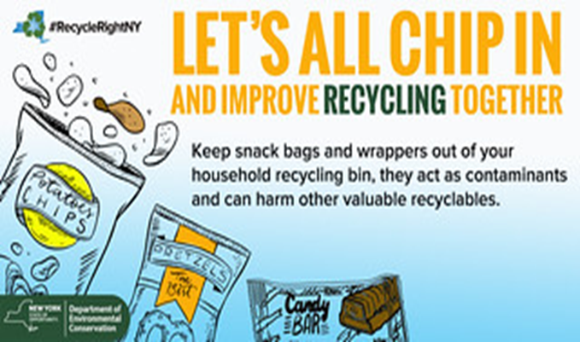
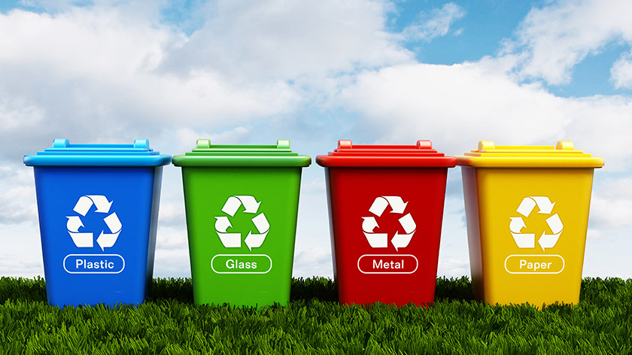
Technology and the Contemporary Environment
Waste Reduction and Recycling
Reducing waste at its source is a better option
Strategies
Reduce packaging
Make packaging more recyclable
Ban or per-bag charges for plastic grocery bags
Reduce size or weight of goods
Increase the longevity of goods

Slide 63
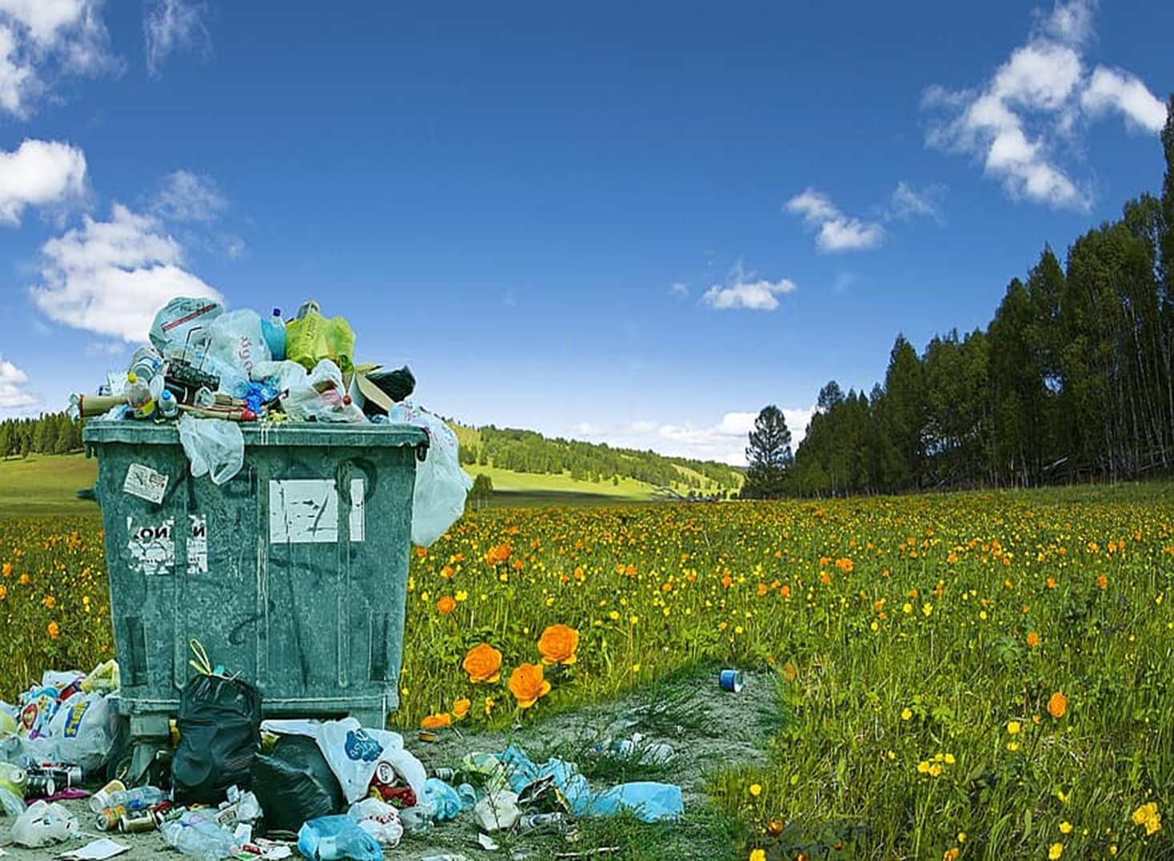
Technology and Contemporary Society
Methods of Waste Disposal
RUBBISH - Short Film [4K] https://www.youtube.com/watch?v=X2OV0n_bm_c

Slide 64
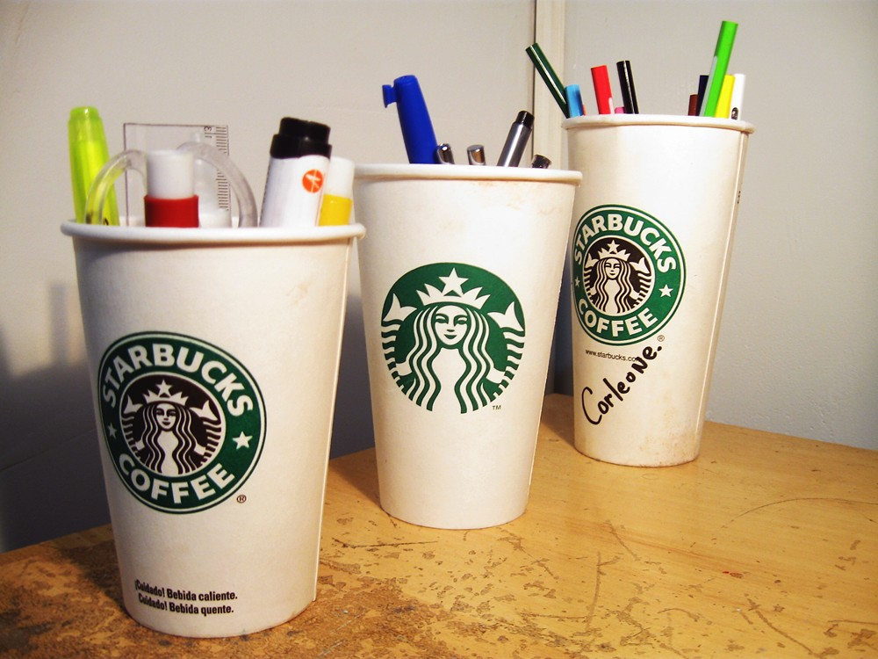
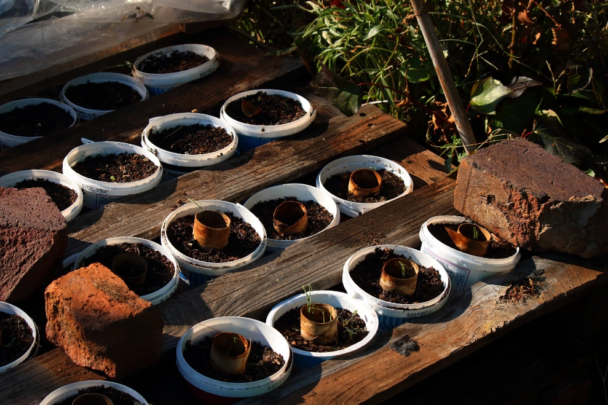
Technology and the Contemporary Environment
Waste Reduction and Recycling
Reuse is one main strategy for waste reduction
Donate used items to charity
Reuse boxes, paper, plastic, wrapping paper, and so on
Buy groceries in bulk
Decline bags at stores and bring cloth bags shopping
Bring your own cup to coffee shops

Slide 65
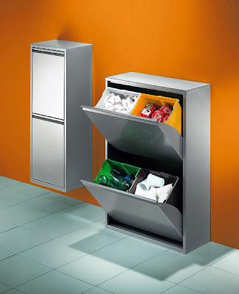
Technology and the Contemporary Environment
Waste Reduction and Recycling
Buy rechargeable batteries
Select goods with less packaging
Compost kitchen and yard wastes
Rent or borrow items instead of buying them

Slide 66
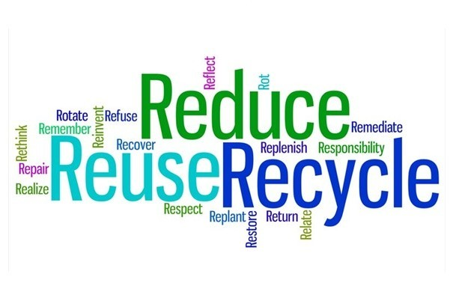
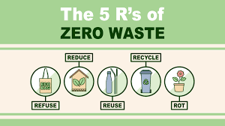

Technology and the Contemporary Environment
Waste Reduction and Recycling
Applying the 5 R's to waste management and recycling strategies can positively impact the outcome of significantly reducing the amount of waste our society generates.
In the 5 R's hierarchy, remember to treat recycling as a last resort after attempting to refuse, reduce, reuse or repurpose. Before disposing of your waste, walk through each of these steps in the following order:

Slide 67
Technology and the Contemporary Environment
Waste Reduction and Recycling
STEP ONE: REFUSE
Refuse: the first element of the 5 R's hierarchy. Learning to refuse waste can take some practice, but incorporating this step into your waste management strategy is the most effective way to minimize waste.
Being aware of refusing to buy wasteful or non-recyclable products. When shopping with suppliers, refuse unnecessary product packaging and request reusable or returnable containers. Making smarter purchasing decisions and setting standards and expectations early in the process makes it easier for individuals to “refuse” waste in the first place.

Slide 68
Technology and the Contemporary Environment
Waste Reduction and Recycling
STEP TWO: REDUCE
Reduce the use of harmful, wasteful, and non-recyclable products. Reducing dependency on these kinds of products results in less waste materials ending up in landfill and the associated negative environmental impacts.
We recommend always using the minimum amount required to avoid unnecessary waste. For example, when printing a document, print double-sided to cut your waste output in half. Other commonly used items can focus on reducing include single-use plastics, plastic packaging, organic waste, and Styrofoam cups.

Slide 69
Technology and the Contemporary Environment
Waste Reduction and Recycling
STEP THREE: REUSE
Single-use plastics have created a "throw-away" culture by normalizing consumer behavior of using materials once and then throwing them away. The rate at which we consume plastics has become unimaginable, and the plastic crisis has become one of the world's greatest environmental challenges.
In an effort to reduce waste, reuse items instead of buying new ones. Begin by focusing on one area of your life at a time, like the coffee break. Replace all of the single-use eating utensils, Styrofoam cups, water bottles, and paper plates with compostable or reusable alternatives. Once you master one area, prioritize reuse for other products in your home like packaging peanuts, printer cartridges, cardboard boxes, food containers, and rechargeable batteries.

Slide 70
Technology and the Contemporary Environment
Waste Reduction and Recycling
STEP FOUR: REPURPOSE
For every item that can't be refused, reduced, or reused, try repurposing it. Many people in the green community refer to this method as upcycling. You may be surprised to learn how many common products serve more than one purpose. Sometimes it requires using some creativity, but the possibilities are endless.
Try using wasted printer paper for scrap paper, cardboard boxes for storing supplies, binder clips to hold power cords and chargers in place, and even mason jars, coffee mugs, and tin cans for holding pens and pencils. Encourage your family members and colleagues to be aware of items they no longer need and to check how to dispose of them in eco-friendly manner.

Slide 71
Technology and the Contemporary Environment
Waste Reduction and Recycling
STEP FIVE: RECYCLE
Last but definitely not least: recycle. Once you've gone through all of the other R's, recycling is the most environmentally friendly waste disposal method. If your business doesn't already, start collecting cardboard, mixed paper products, commingled materials (plastics, aluminum, glass) and organics. Most companies we speak with are surprised by the amount of waste they reduce by establishing an effective recycling program. Click here for a breakdown of how RoadRunner can work to save your business on waste and recycling management costs.

Slide 72

Technology and the Contemporary Environment
Reduce, Reuse and Recycle, to enjoy a better life | Educational Video for Kids.
https://www.youtube.com/watch?v=OasbYWF4_S8

Slide 73
Technology and the Contemporary Environment
Waste Reduction and Recycling
In simple words, waste management is like taking care of our planet and ourselves. By following good waste management practices, we keep our environment clean, prevent health problems, save resources, and even create jobs.
Waste management is also important for public health. Harmful wastes can cause long term health problems, so it is very important that they are disposed of appropriately and carefully and not mixed in with the normal waste coming out of your home or office.
It's a win-win situation for everyone, and it's something we can all do to make the world a better place. So, let's keep practicing proper waste management and take care of our beautiful planet earth!

Slide 74
Technology and the Contemporary Environment
Technology and Contemporary Society
Conclusion

Slide 75
Technology and the Contemporary Environment
Conclusion
Modern methods of waste management are far safer for people and gentler on the environment
Recycling and composting are making rapid progress
Canada has changed from virtually no recycling to diverting nearly 25% of all solid waste
Our prodigious consumption habits have created more waste than ever before
Finding ways to reduce, reuse and efficiently recycle the materials and goods that we use stands as a key challenge for this century

Slide 76
Technology and the Contemporary Environment
Waste management: a crucial practice to safeguard our Planet
Waste management is not merely a method of getting rid of waste: to reach a greener future, it is mandatory that we adopt waste reduction and recycling practices on both individual and collective levels. Governments, businesses, and individuals must collaborate to promote sustainable waste management and implement innovative solutions. Investing in waste management infrastructure, supporting recycling initiatives, and raising awareness about responsible consumption and disposal habits are essential steps to safeguarding our planet's well-being for future generations.

Slide 77

Technology and the Contemporary Environment
Technology and the Contemporary Environment
QUESTIONS | SUGGESTIONS | COMMENTS

Slide 78

Technology and the Contemporary Environment
Do you have any questions?
Email: hugh.simmonds@torontomu.ca

